Slide 1
损失景观的嵌入原则
许志钦
上海交通大学
2025年10月5日星期日

Slide 2
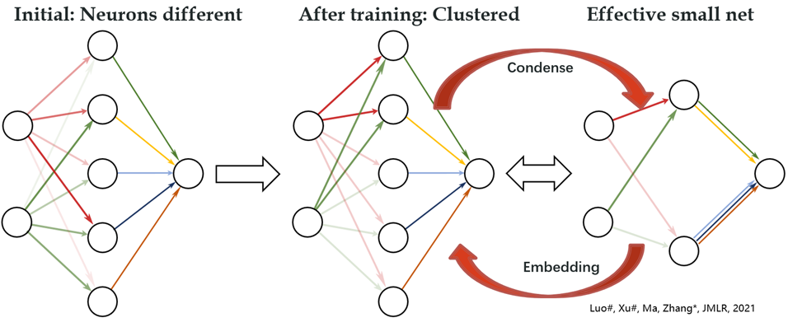

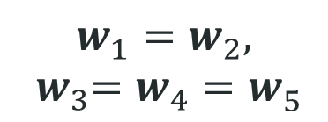
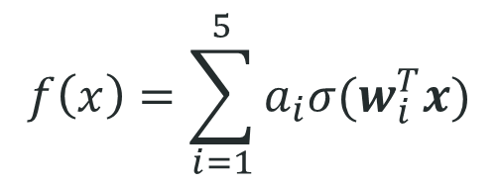
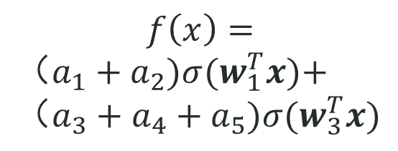
Condensation
$$f\left(x\right)=\sum_{i=1}^{5}{a_{i}σ(w_{i}^{T}x)}$$
$$f\left(x\right)=$$
$（a_{1}+a_{2})σ(w_{1}^{T}x)\text{+}$ $（a_{3}+a_{4}+a_{5})σ(w_{3}^{T}x)$
$$w_{1}^{ }=w_{2}^{ },$$
$${ w}_{3}^{ }=w_{4}^{ }=w_{5}^{ }$$
Initial：random
After training：
Condense
Effective：
Small net

Slide 3
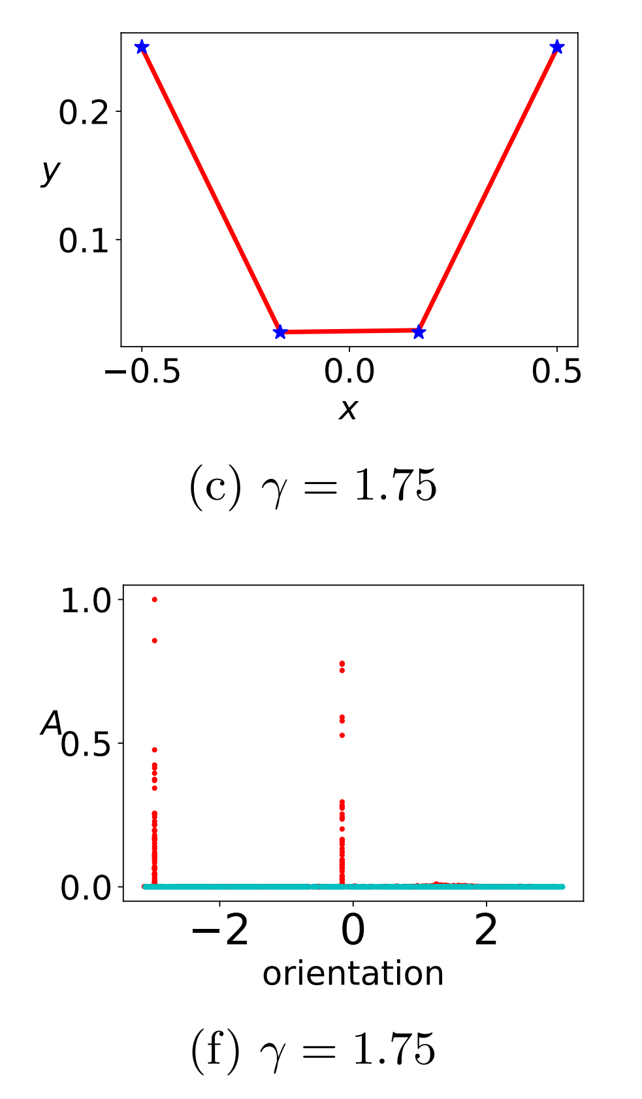
Few effective neurons
Two ReLU neurons are enough!
Tao Luo#, Zhi-Qin John Xu #, Zheng Ma, Yaoyu Zhang*,
Phase diagram for two-layer ReLU neural networks at infinite-width limit, Journal of Machine Learning Research (2021)

Slide 4
Few effective neurons
The original large network
Similar?
Two ReLU neurons network!
Why do not just train small network???
[6] Luo#, Xu#, Ma, Zhang*, 2007.07497, JMLR

Slide 5
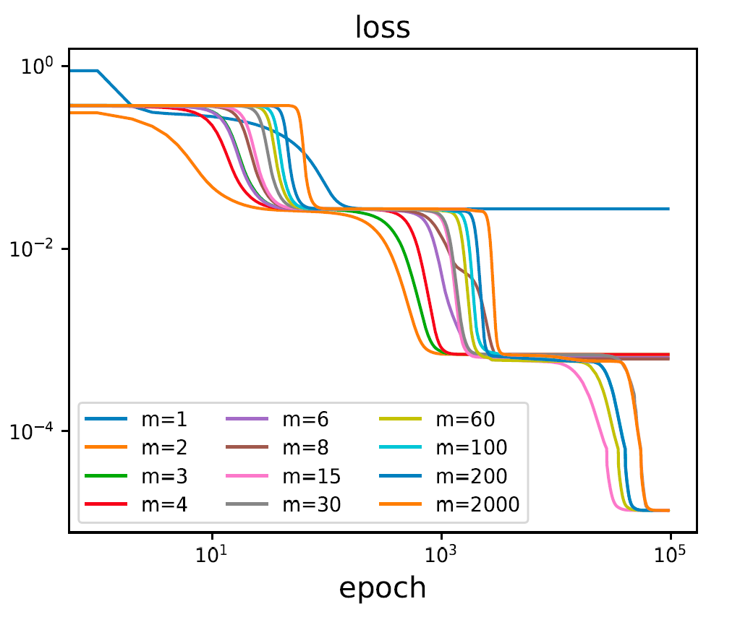
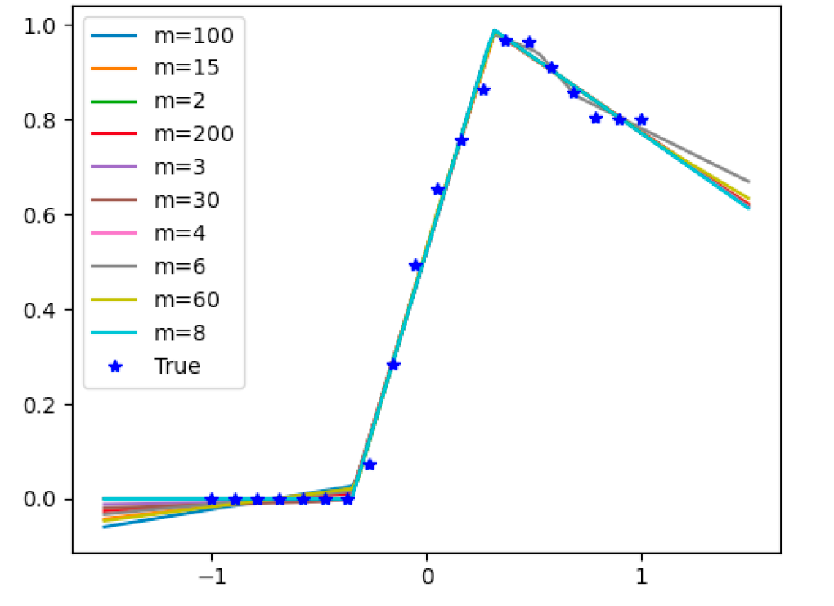
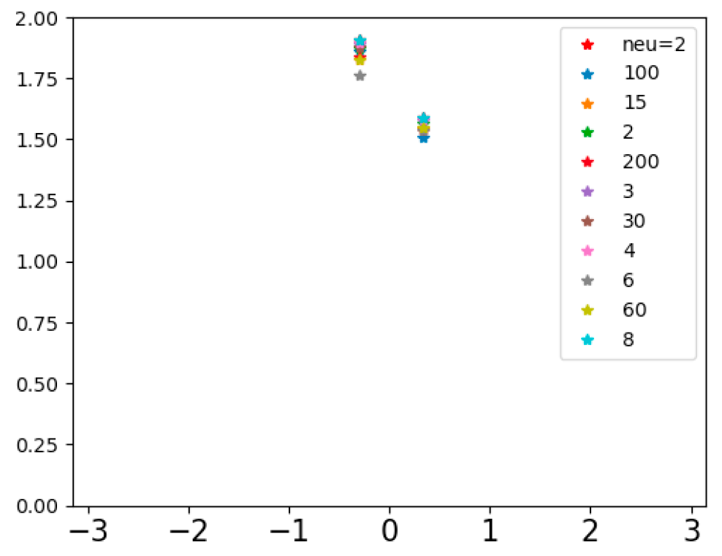
NN of diff width go through same point
1 similar saddles
2 same loss
3 same output
4 similar condense
输出图
Amplitude
凝聚图
orientation
Zhang*, Zhang, Luo, Xu*, NeurIPS (spotlight), 2021

Slide 6
Study similarity and difference of different widths from Loss Landscape

Slide 7
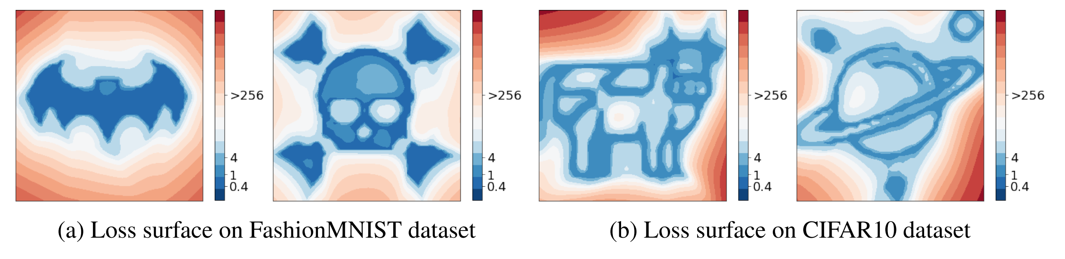
Loss landscape can be any pattern
I. Skorokhodov, M. Burtsev, 2019

Slide 8
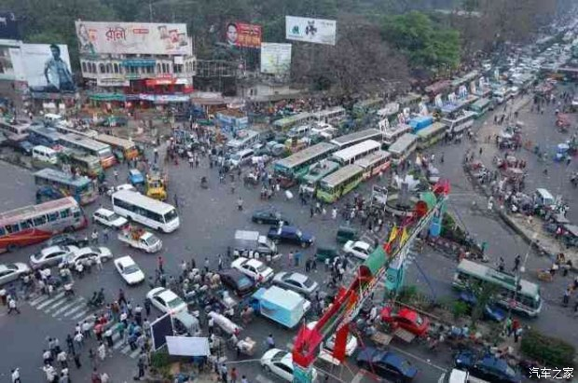
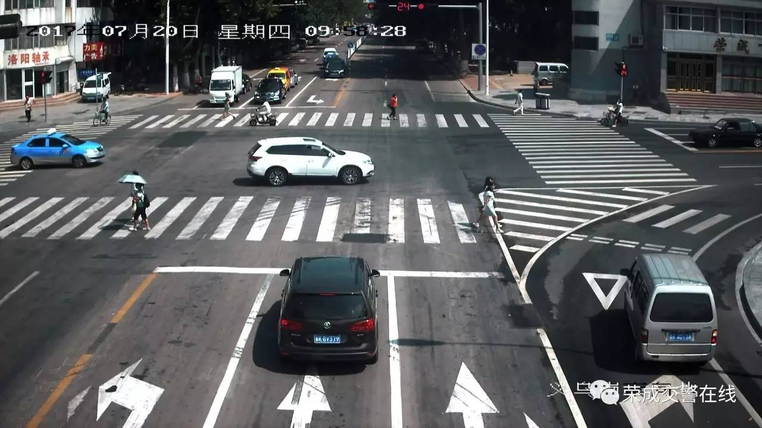
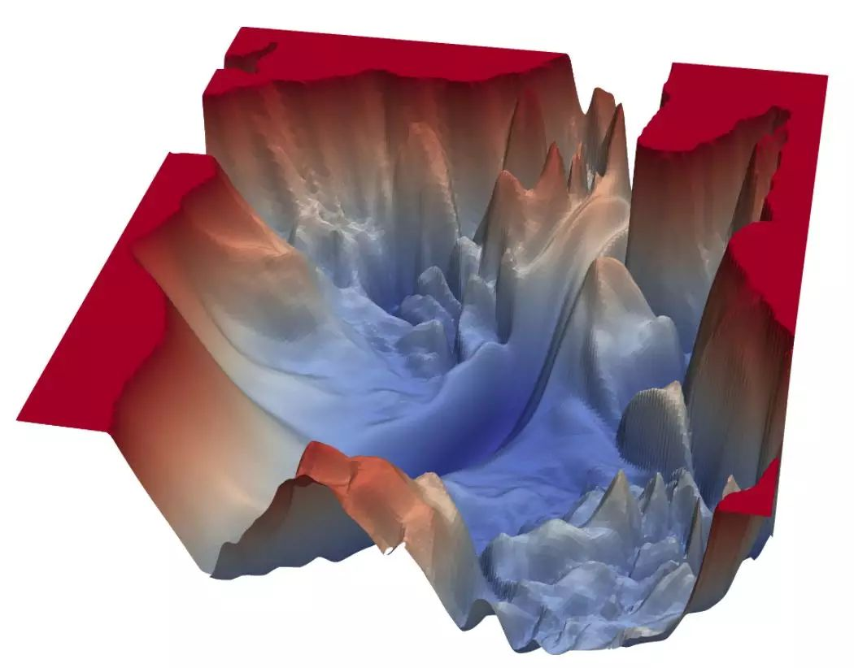

How to survive in such complex configurations
Li et al., arXiv:1712.09913

Slide 9
Who can be a traffic policeman in training?

Slide 10
Saddle point
Characteristics:
1, attract the trajectory
2, slow down the training

Slide 11
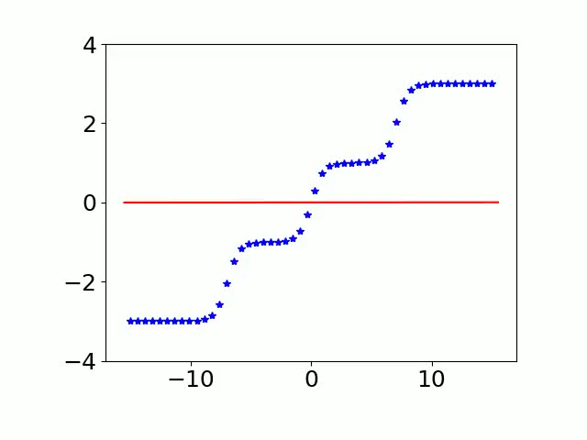
Another viewpoint for training process
关注停留很久的位置：一个神经元能拟合最好的位置？
500 tanh neurons
Single-neuron net optimum
Three-neuron net optimum
[16] Zhang*, Zhang, Luo, Xu*, NeurIPS (spotlight), 2021

Slide 12
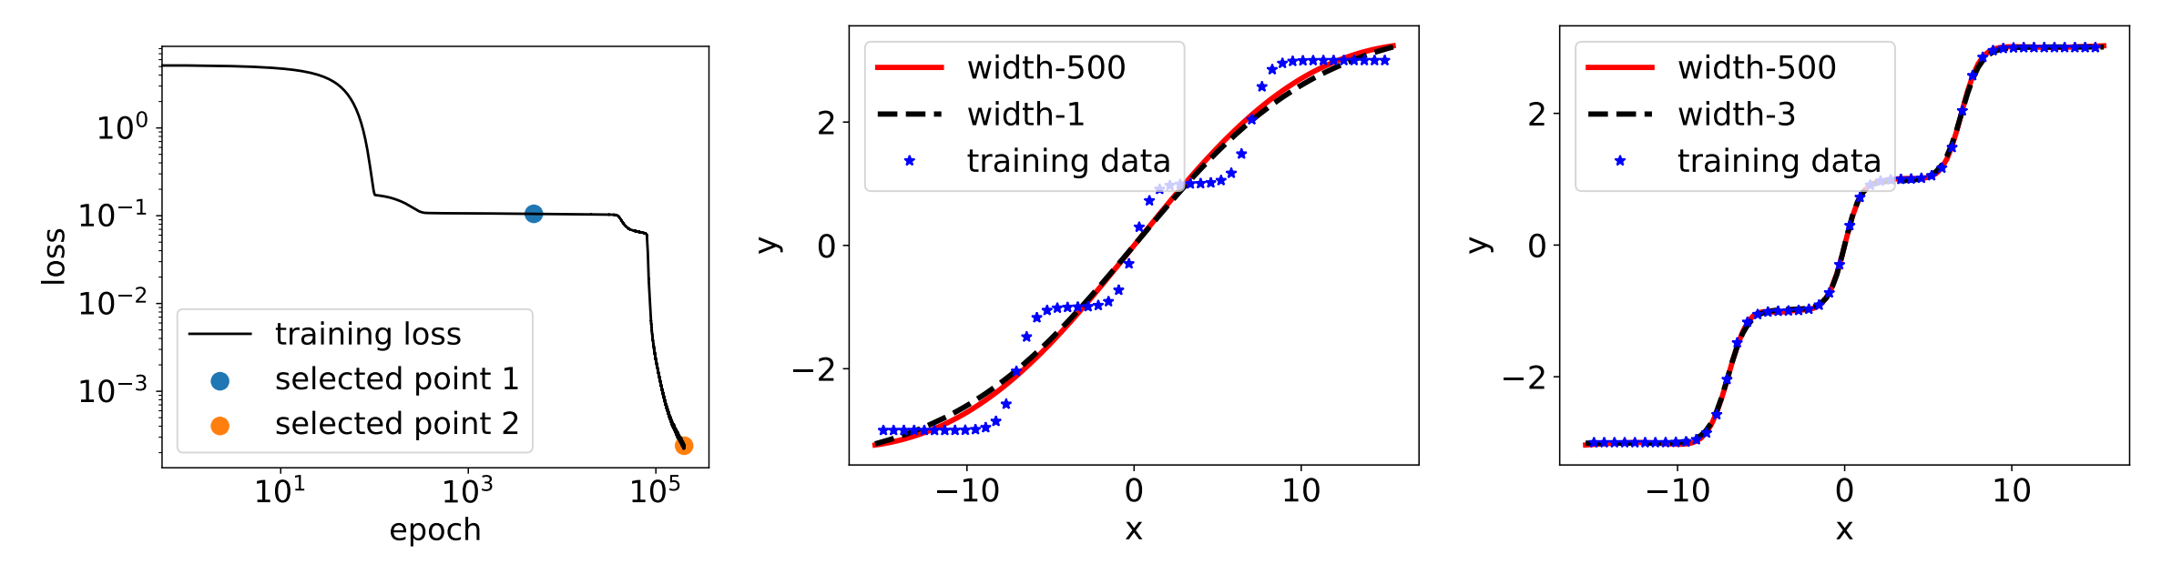
Critical points
Critical points:
1. Related to output, in some sense, can be defined by output but not parameters.
2. Critical points of wide NN should contain/see critical points of narrow NN
[16] Zhang*, Zhang, Luo, Xu*, NeurIPS (spotlight), 2021

Slide 13
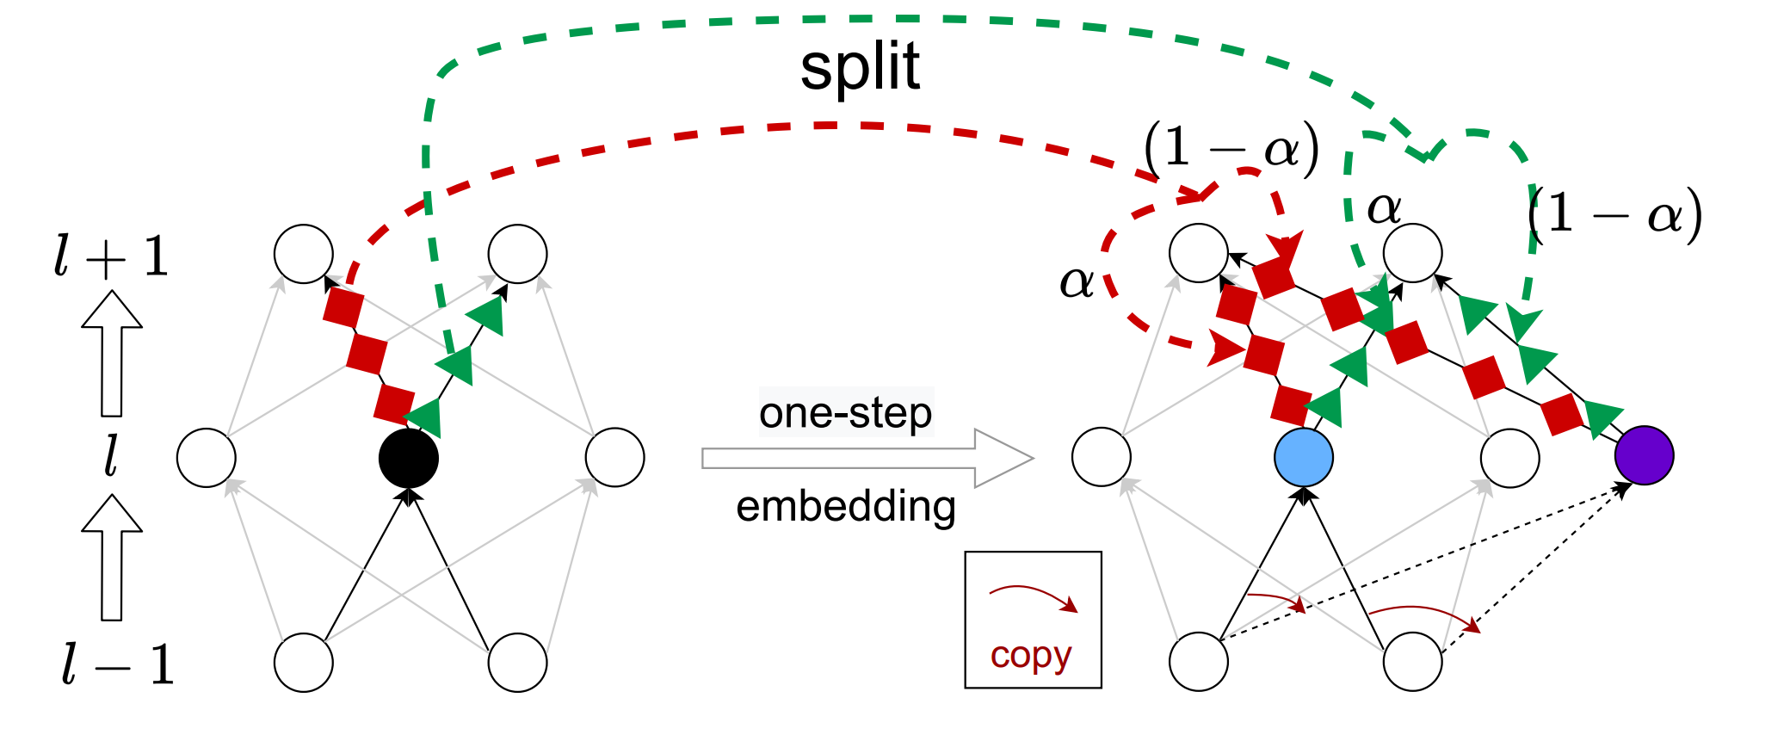
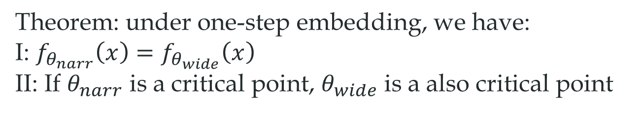
Embedding principle
the loss landscape of any network “contains” all critical points of all narrower networks.
Theorem: under one-step embedding, we have:
I: $f_{θ_{narr}}\left(x\right)=f_{θ_{wide}}\left(x\right)$
II: If $θ_{narr}$ is a critical point, $θ_{wide}$ is a also critical point
Condensation
[16] Zhang*, Zhang, Luo, Xu*, NeurIPS , 2021

Slide 14
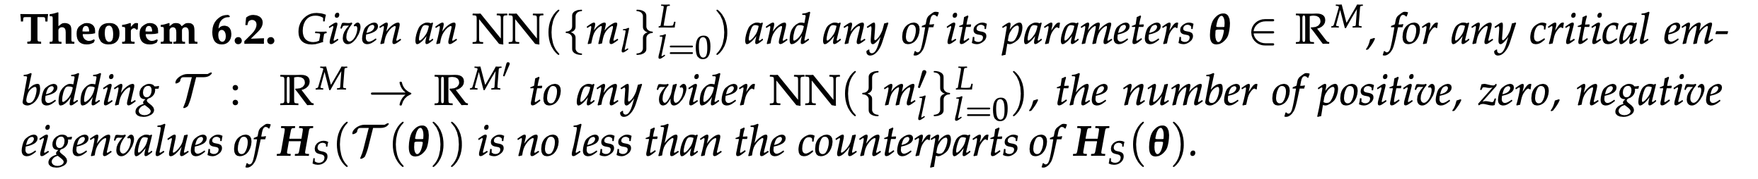
Properties
Larger network, larger degeneracy
Larger network, almost more descent directions
Zhang*, Li, Zhang, Luo, Xu*, Journal of Machine Learning, 2022, Zhang*, Zhang, Luo, Xu*, NeurIPS (spotlight), 2021

Slide 15
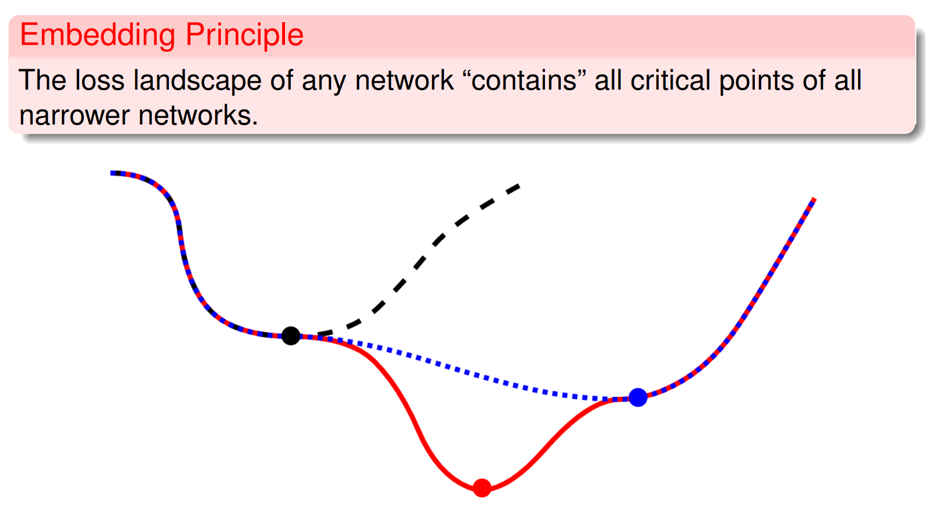
[16] Zhang*, Zhang, Luo, Xu*, NeurIPS, 2021

Slide 16
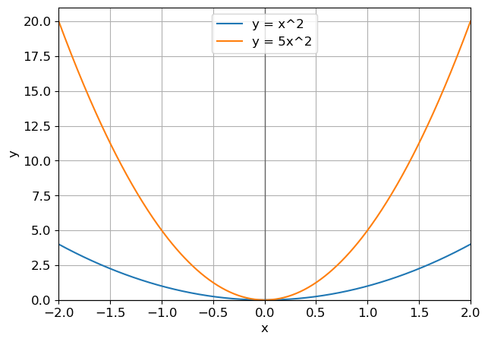
最小点的体积：越平越大
直观：来自越小的网络嵌入的极小值点，退化程度越高，体积越大，越容易吸引训练轨迹

Slide 17
Conjecture
training goes from small-net optimum to large-net optimum
Initial
Theoretical basis: optimum function of small net is a critical function of large network
1-neu net optimum
3-neu net
optimum
…

Slide 18
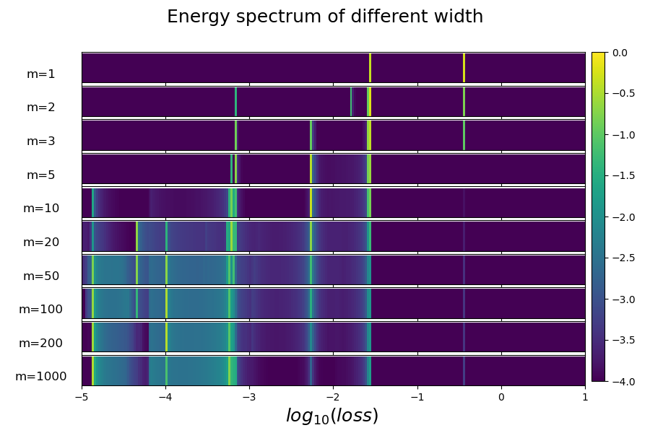
Loss spectrum: distribution over multi-trials
For a net with m neurons,
Train from different initialization with same distribution multiple trials
Count the frequency of all loss values in a small interval
Color: frequency
Stagnation
Zhang*, Zhang, Luo, Xu*, NeurIPS (spotlight), 2021

Slide 19
Loss spectrum: distribution over multi-trials
Larger net,
Easier to decay
Zhang*, Zhang, Luo, Xu*, NeurIPS (spotlight), 2021

Slide 20
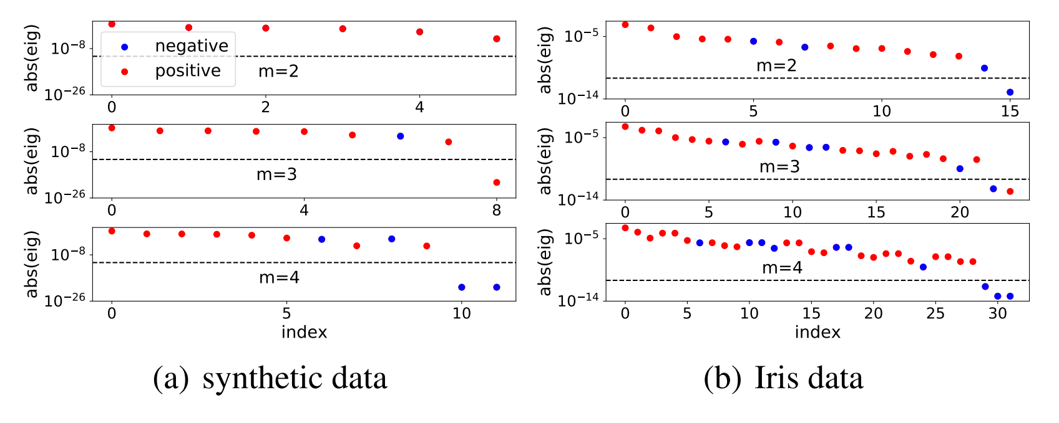
Degeneracy
Comments: maybe why wider is easier for training:
not local minima, more descent directions
Zhang*, Zhang, Luo, Xu*, NeurIPS (spotlight), 2021

Slide 21


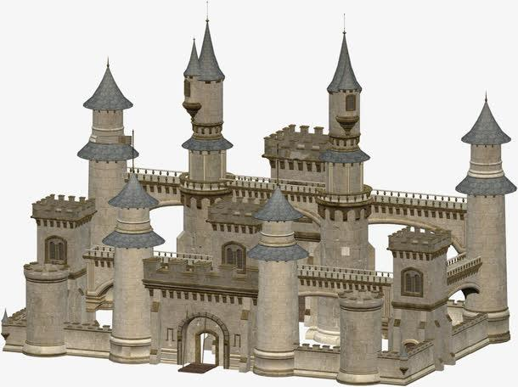



An intuitive conjecture: guided by smaller NNs’ critical points
3-neu’s critical point
6-neu’s critical point
2-neu’s critical point
4-neu’s critical point
1-neu’s critical point
5-neu’s critical point
Initial parameters

Slide 22
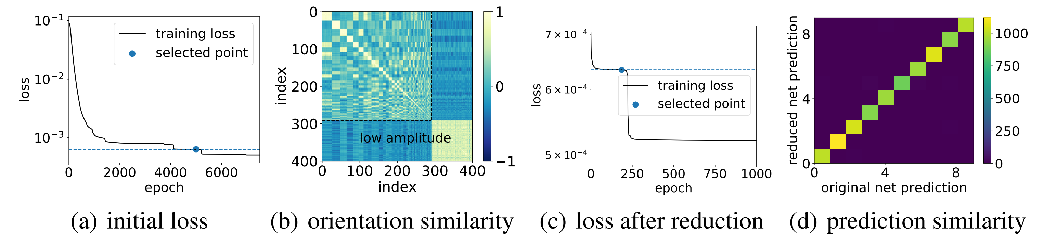
Pruning
MNIST data, 400 hidden neurons→58 hidden neurons.
Zhang*, Li, Zhang, Luo, Xu*, Journal of Machine Learning, 2022, Zhang*, Zhang, Luo, Xu*, NeurIPS (spotlight), 2021

Slide 23
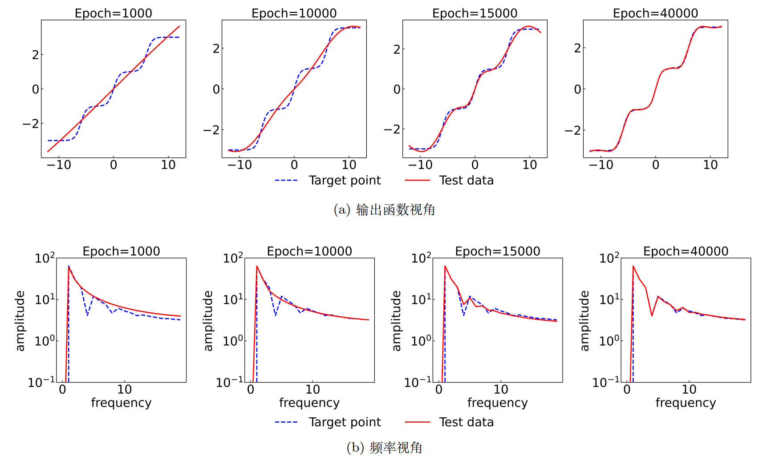
嵌入原则和频率原则的关系
两层、宽度为 500 的 tanh 神经网络

Slide 24
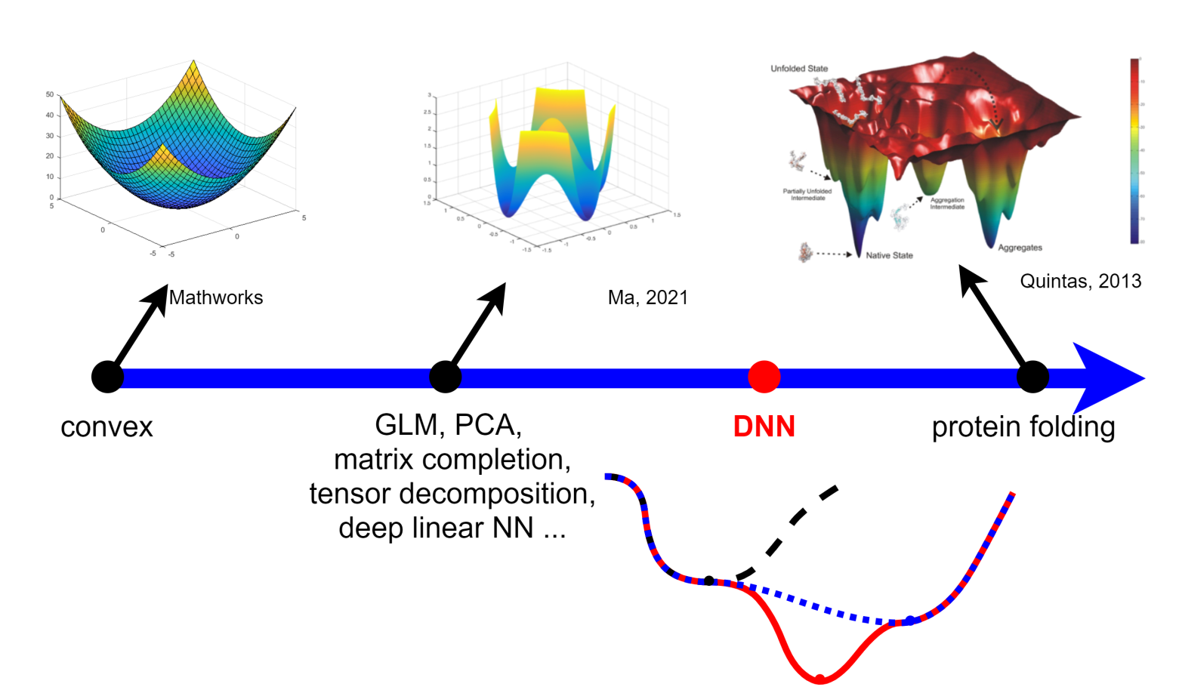
Suggested picture of DNN loss landscape
Zhang*, Li, Zhang, Luo, Xu*, Journal of Machine Learning, 2022, Zhang*, Zhang, Luo, Xu*, NeurIPS (spotlight), 2021

Slide 25
Embedding Principle:
the loss landscape of any network
“contains”
all critical points of all narrower networks.
E-Principle: a basis for condensation,
a path for gradually increasing the # of effective neurons
Occam’s Razor
If no need, no more effective neurons
Small net is effective
Zhang*, Li, Zhang, Luo, Xu*, Journal of Machine Learning, 2022, Zhang*, Zhang, Luo, Xu*, NeurIPS (spotlight), 2021

